Slide 1
Why Is This Important?
Most people request information for 1 of 4 reasons:
  They don’t have protection.
  They need more protection.
  They want to leave money behind for a loved one.
  An estate could be in probate for quite some time causing lifestyle changes . . .
What are your Needs?
  To alleviate financial burden?
  To replace loss of income?

Slide 2
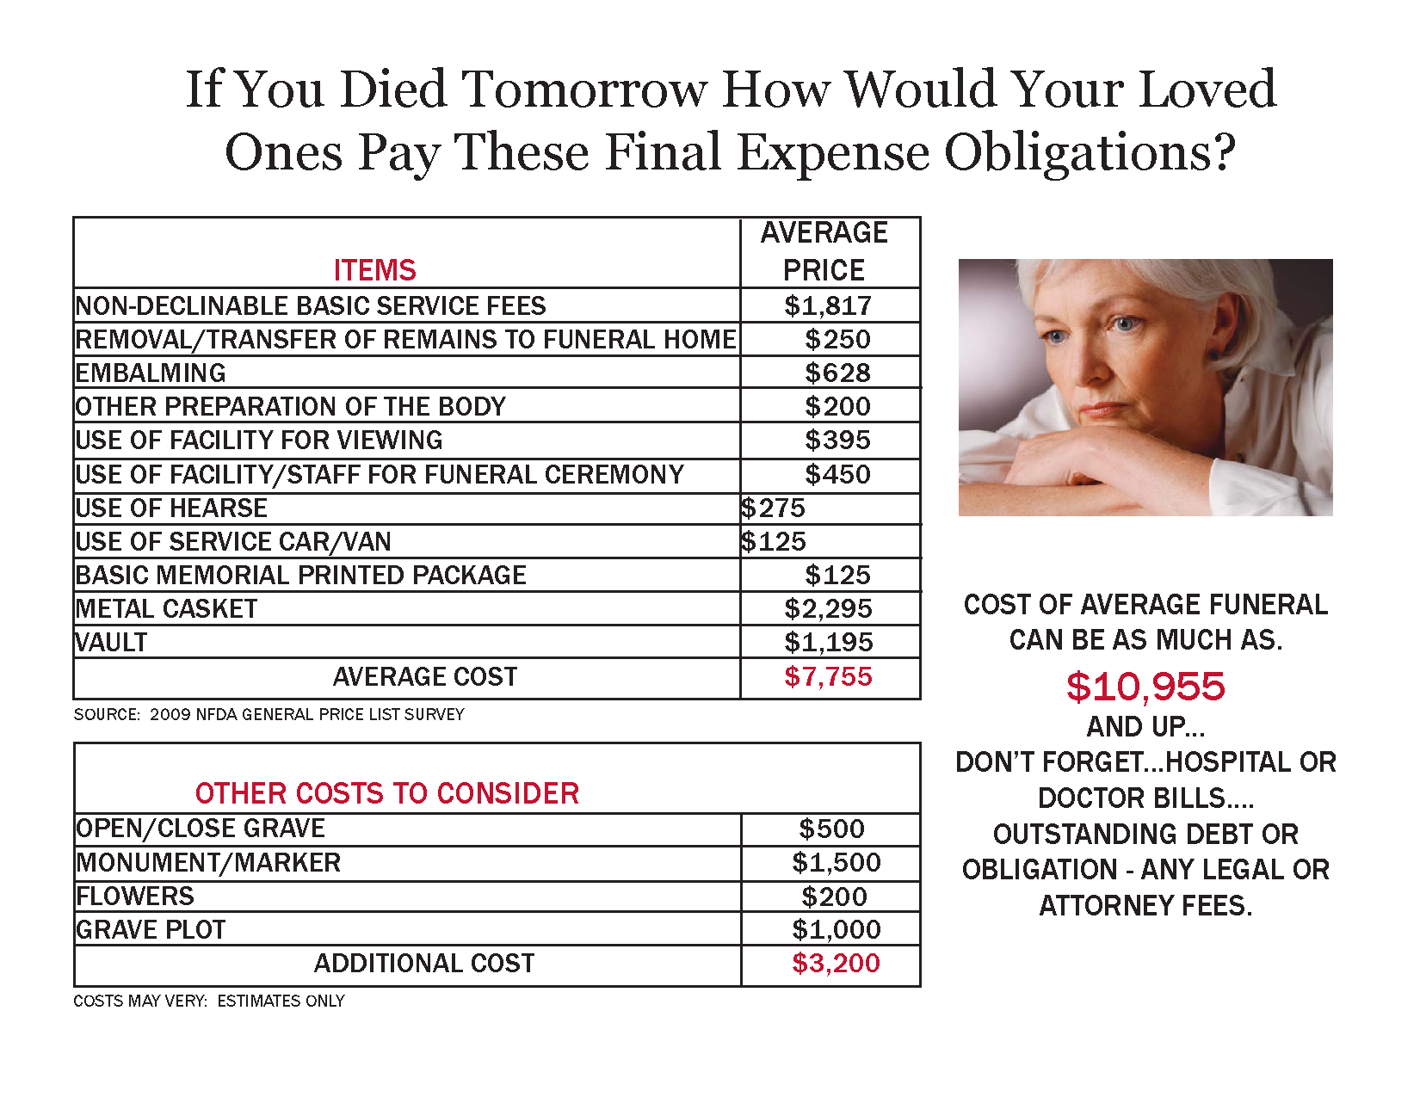

Slide 3
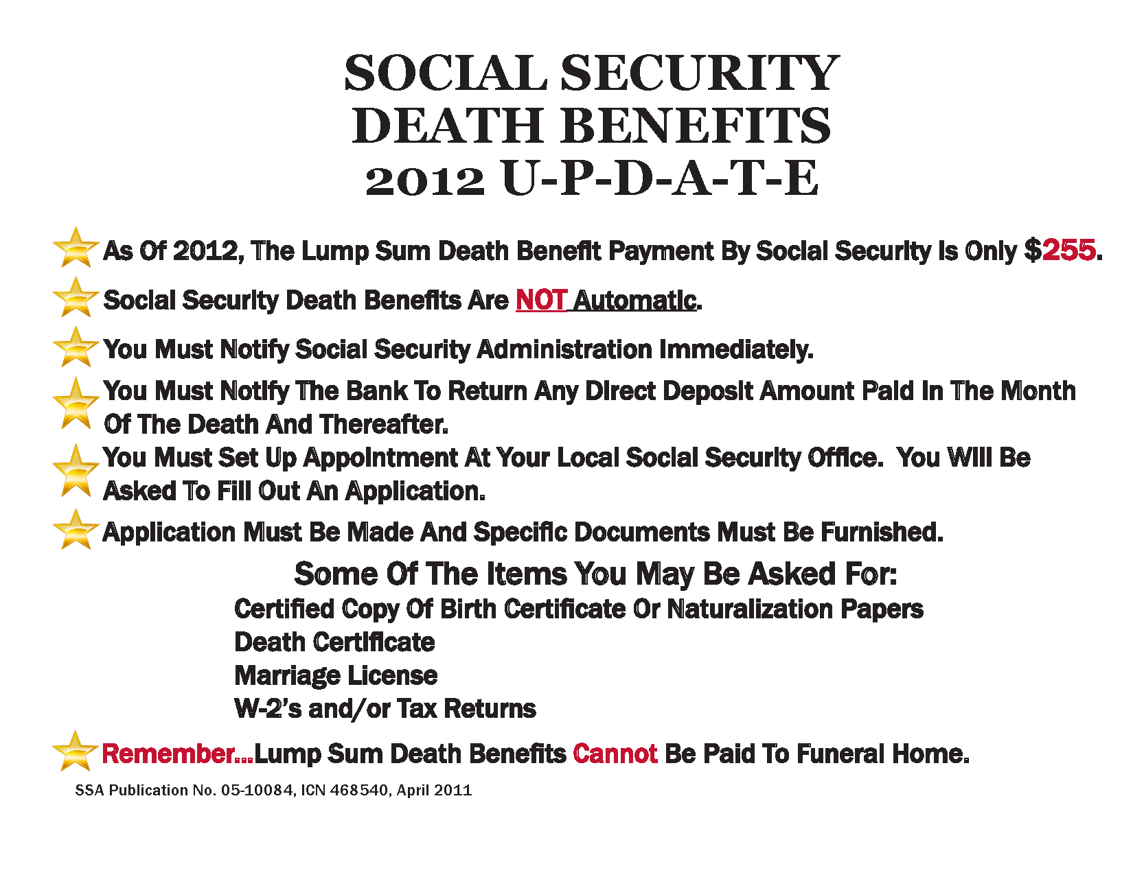

Slide 4
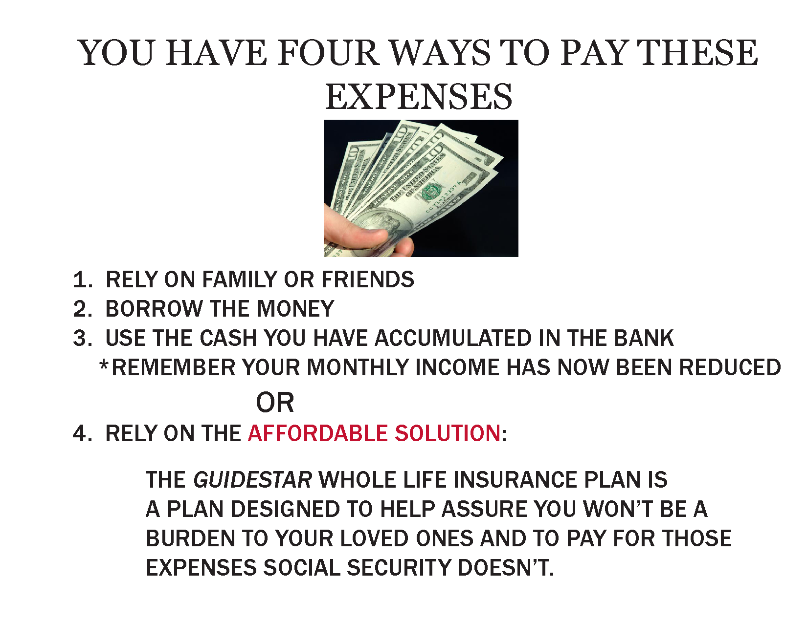

Slide 5
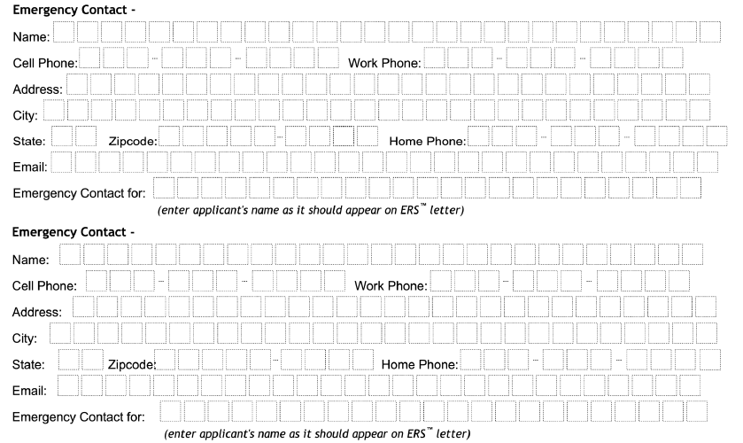
Emergency Response System

Slide 6
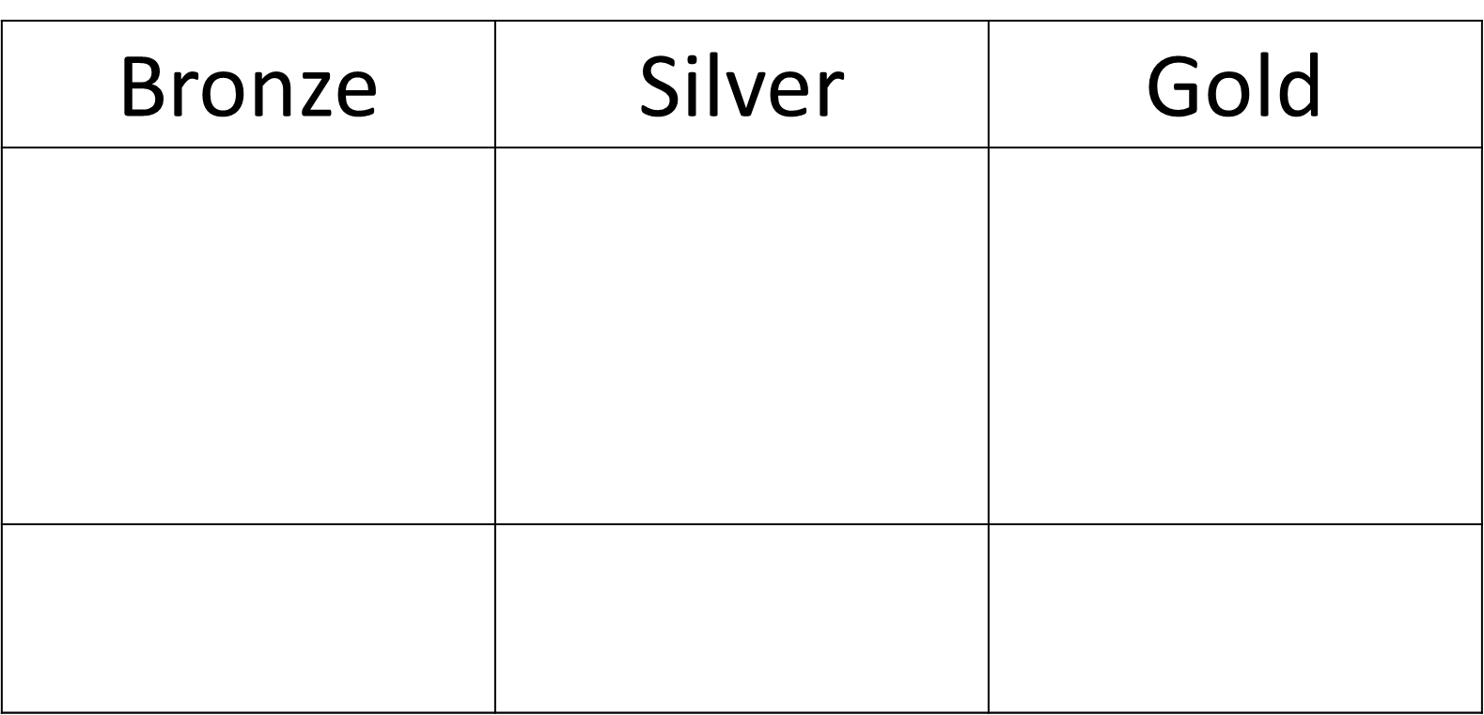

Slide 7
Final Questions
Do you feel good about taking care of your family today for ________ per month?
Is there anything you can think of that would prevent you from keeping this payment going?
Please call no matter how minor the questions you might have.
Any questions?

Slide 8
Safe Money
How much of your current retirement can you afford to lose?
Do you consider yourself a saver or an investor?
Are you concerned that you will outlive your money?
Did you know there is a cash accumulation account with insurance companies that is guaranteed and offers up to 10% bonus on your principal deposit?

